Slide 1

Multi-Level Smart Alarm System
Professor: Ahmet Gurhanli
Team Member:
Asma Atiah – 22040102149
Shahd Atayturkmen-22040102137
Ayet Selim – 22040102159
Malak Medhat - 22040102054

Slide 2
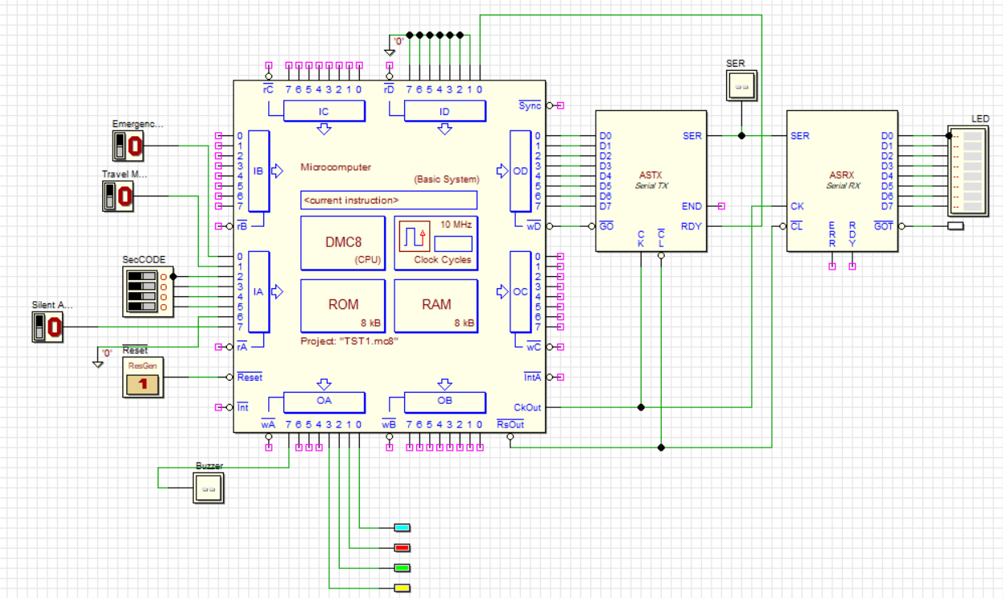
General Idea:
The Multi-Level Smart Alarm System (ML-SAS) is an advanced 8-bit embedded security solution powered by the DMC8 microcomputer. It is designed to provide dynamic security responses based on the user's environment through three distinct operating levels:
Normal/Home Mode: Monitors basic security parameters with visual status feedback.
Travel/Vacation Mode: Enhances sensitivity and activates presence simulation to protect the premises during long absences.
Emergency Mode: A high-priority interrupt state for immediate threat response with synchronized audio-visual alarms.

Slide 3
Input Ports:
IA0 (Emergency): High-priority trigger for immediate danger.
IA1 (Travel1 Mode): Activates the long-term absence protection logic.
IA2-IA5:(SecCODE) The 4-bit hardware interface for the security passcode (14h).
IA7 (Silent Mode): Toggles between audible alarms and discrete notifications.

Slide 4
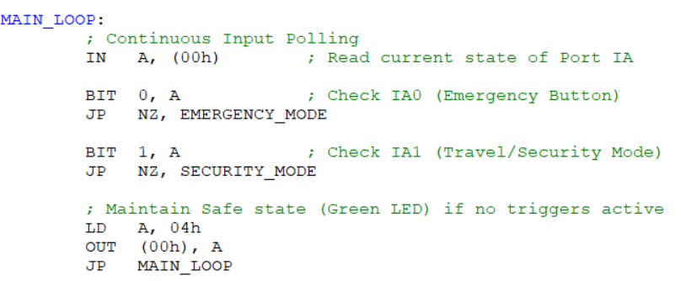
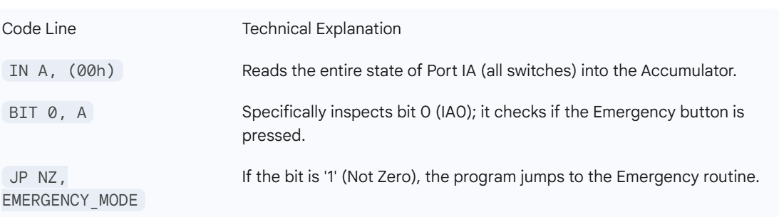
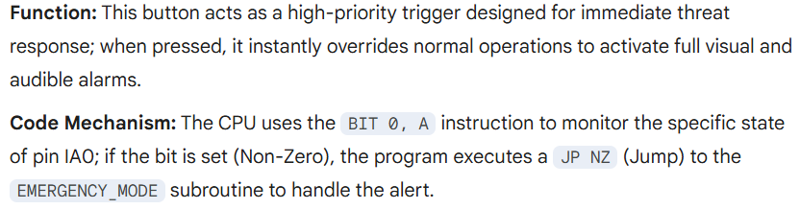
IA0: Emergency Button

Slide 5
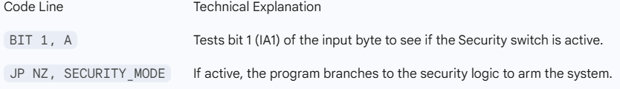
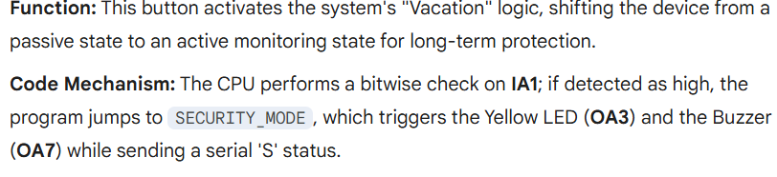
2. IA1: Travel Mode Explanation

Slide 6
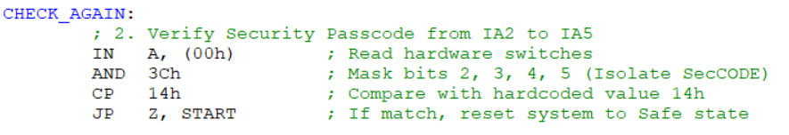
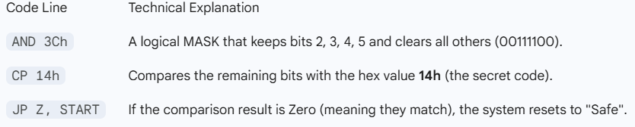
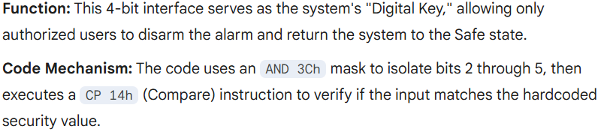
2. IA2–IA5: Security Code (SecCODE)

Slide 7

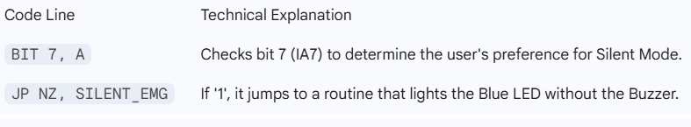
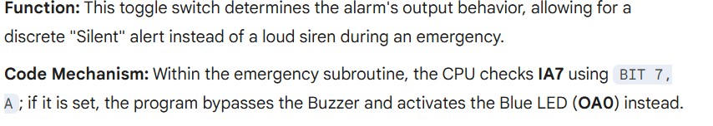
3. IA7: Silent Mode

Slide 8
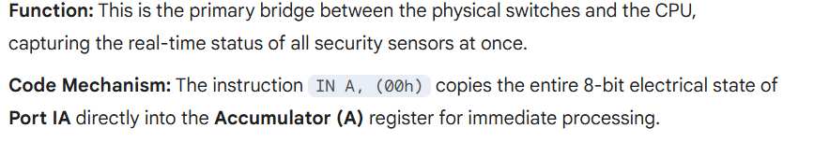
4. Data Acquisition:

Slide 9
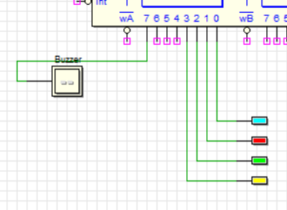
Output Ports:
OA2 (Green LED): Indicates the Safe State; the system is powered on and no intrusion or emergency is detected.
OA1 (Red LED): High-visibility Emergency Alert; flashes or stays on to signal immediate danger or a panic trigger.
OA3 (Yellow LED): Indicates Travel/Security Mode; the system is in a high-sensitivity state for long-term protection.
OA0 (Blue LED): Silent Alarm Indicator; provides a visual-only notification when the audible buzzer is toggled off via Silent Mode.
OA7 (Audible Buzzer): Provides the Acoustic Warning; sounds during Emergency or Security breaches to alert the surroundings.

Slide 10
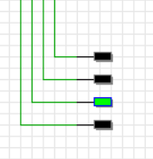

1. Visual Feedback Green LED (Safe State):

Slide 11
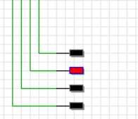
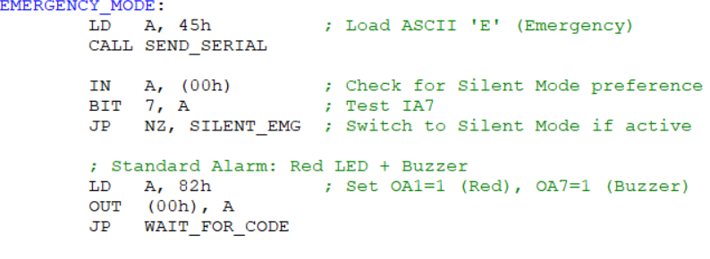

2. Visual Feedback
Red LED (Emergency Alert):

Slide 12
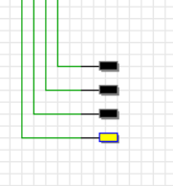

3. Visual Feedback Yellow LED (Security/Travel Mode):

Slide 13
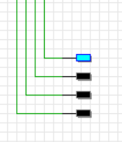
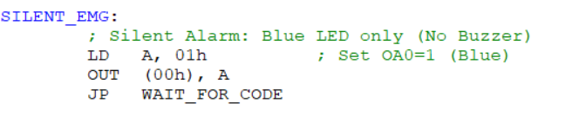

4. Visual Feedback: Blue LED (Silent Alarm)

Slide 14
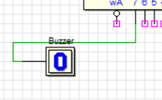
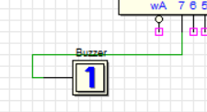

5. Audio Output: The Buzzer

Slide 15
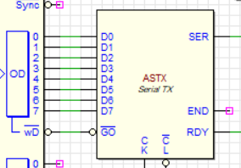
6. Serial Data Output: ASCII Status (Port OD)

Slide 16
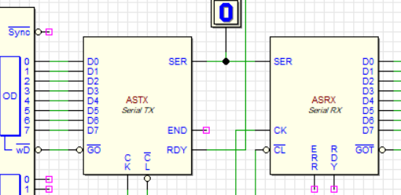
Serial Communication (Remote Interface):
ASTX (Serial Transmitter): Responsible for sending system status data to a remote terminal. It converts the 8-bit parallel data from the OD Port into a serial bitstream.
ASRX (Serial Receiver): Responsible for receiving incoming serial data. In this system, it can be used to monitor the status characters ('G', 'E', 'S') sent by the controller.
RDY Signal (Handshaking): A feedback signal from the transmitter to the CPU (connected to ID0). It tells the processor to wait until the transmitter is ready to send the next character, preventing data loss.

Slide 17

Serial Communication (Remote Interface) 2:
Status Codes (ASCII): The system transmits specific letters to represent the current state:
  'G' (47h)(01000111): System is Good/Safe.
  'E' (45h)(01000101): Emergency alert detected.
  'S' (53h)(01010011): Security/Travel mode active.

Slide 18
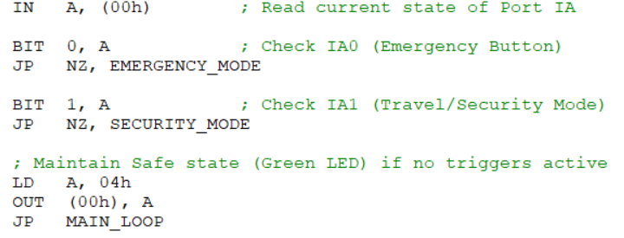
State Machine Logic (Decision Making)
The system doesn't just run line by line; it "decides" which mode to enter based on input priority:
Bit Testing: The CPU uses the BIT instruction to constantly poll (check) the status of the input pins.
Conditional Jumping: Depending on the results, the system uses JP NZ (Jump if Not Zero) to switch states:
  Normal Path: Stays in a loop checking for activity.
  Emergency Path: Overrides all functions if IA0 is triggered.
  Security Path: Enters the monitoring state if IA1 is active.

Slide 19
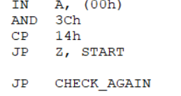
The Security Protocol (The Digital Lock)
Explain how the system verifies the user’s identity before disarming the alarm:
Input Isolation (AND Masking): To read the passcode from IA2–IA5, the CPU uses AND 3Ch. This ignores all other switches and only focuses on the 4-bit code.
Comparison Logic (CP Instruction): The instruction CP 14h compares the user’s input directly with the hardcoded secret value (14h).
Validation: * If the result is a match (Zero Flag set), the system jumps to START to reset the alarm.
  If the result is wrong, it remains in the CHECK_AGAIN loop, keeping the alarm active.

Slide 20
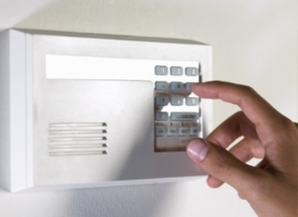
Multi-State Monitoring: Offers four distinct operational modes: Safe, Emergency, Security (Travel), and Silent, each with unique visual and audible indicators.
Secure Passcode Verification: Implements a digital lock mechanism that requires a specific 4-bit passcode (14h), verified through bitwise AND masking and logical comparison.
Dual-Layer Alert System: Combines visual notifications via multi-colored LEDs with an audible Siren (Buzzer) for comprehensive user alerting.
Selective Alerting (Silent Mode): Features a dedicated Silent Alarm (Blue LED) that can be toggled via hardware switch (IA7) to provide discrete notifications without sounding the buzzer.
Real-Time Status Reporting: Utilizes Serial Communication (TX/RX) to transmit ASCII status codes ('G', 'E', 'S') for remote monitoring and system tracking.
Reliable Hardware Handshaking: Integrates a RDY signal to synchronize the CPU with the transmission module, preventing data loss during communication.
System Key Features:

Slide 21
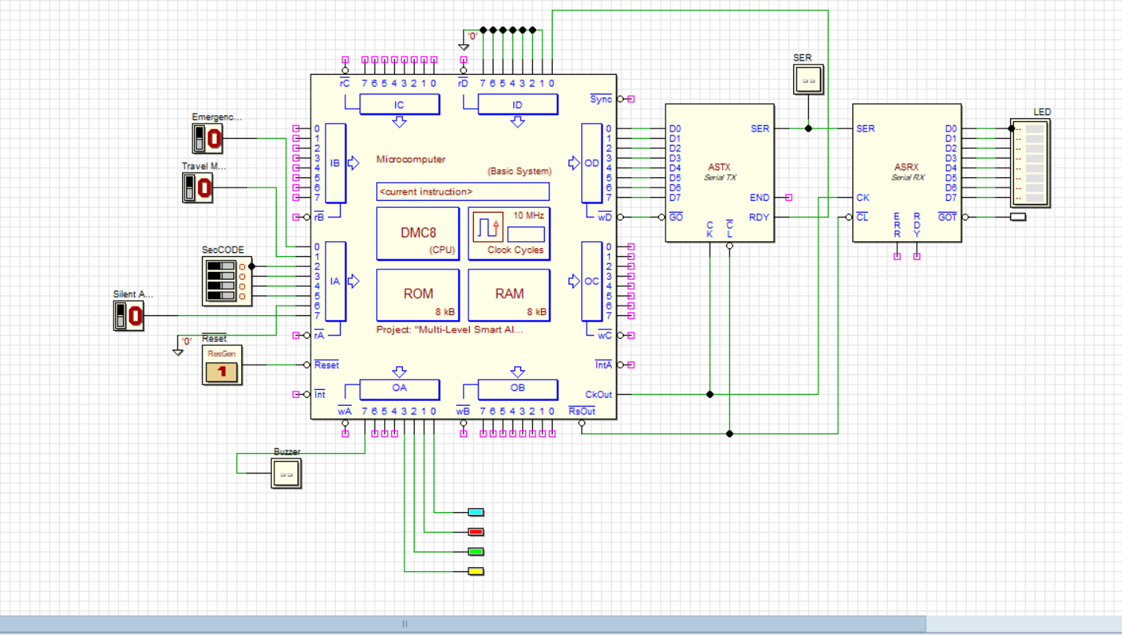

Slide 22
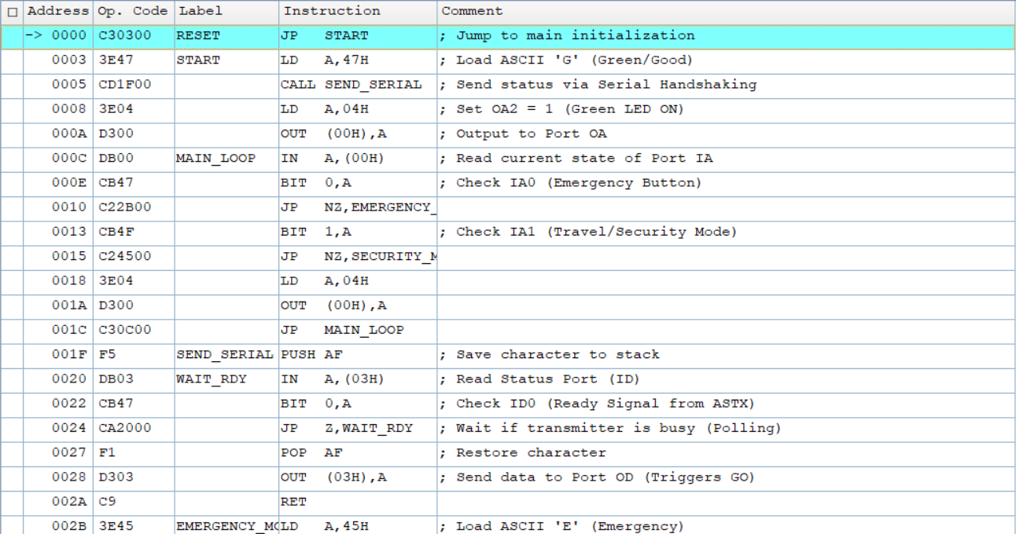

Slide 23
